Slide 1
Topic: Motivation
Dr. C. Vijaya Banu
Professor , School of Management
SASTRA Deemed University, Thanjavur – 613 401
vijayabanu@mba.sastra.edu

Slide 2
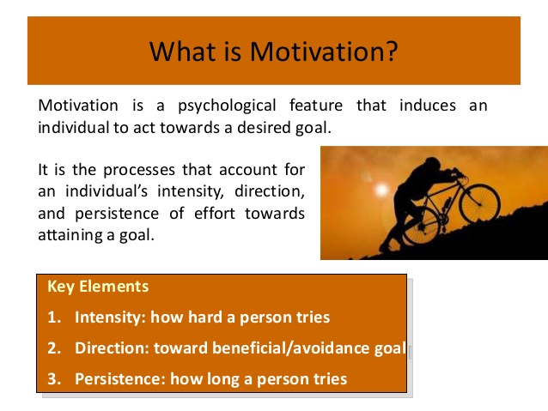

Slide 3
Human behaviour is controlled, directed and modified through certain motives. When person is hungry and is searching for food, or constructing a house, or mating, or learning new skills, we will always be able to trace a motive to guides is activities and behaviour to success or failure.
Need- Either physiological or psychological imbalance
Drives •Set up to alleviate needs. •Action oriented •Providing an energizing thrust toward reaching an incentive •Ex: Hunger/thirst drive Incentive Anything that alleviate & reduce a drive
Motive is a force that determine the activity of an individual. It energizes and direct his behaviour along this or that channels. When a motive is at work, it creates tension and this arouses the individuals towards an activity that will relieve the tension

Slide 4
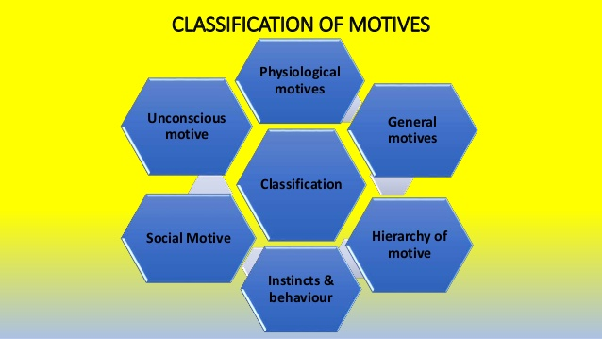
Motivation Concepts

Slide 5
What is Motivation?
Motivation
The processes that account for an individual’s intensity, direction, and persistence of effort toward attaining a goal.
Key Elements
Intensity: how hard a person tries
Direction: toward beneficial goal
Persistence: how long a person tries

Slide 6
Motivation
Latin word -MOVERE’ – ‘To move’ -Motivation is a process that starts with a physiological or psychological deficiency or need that activates a behaviour or a drive that is aimed at a goal or incentive. (F.Luthens,1995)Motivation is the process of arousing the action, sustaining the activity in process and regulating the pattern of activity”.
“Motivation refers to the states within a person or animal that drives behaviour toward some goals” –
1. Intrinsic Motivation -is a type of motivation in which an individual is being motivated by internal desires.
2. Extrinsic Motivation -, on the other hand, is a type of motivation in which an individual is being motivated by external desires.

Slide 7
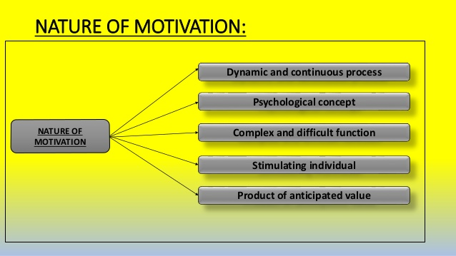

Slide 8
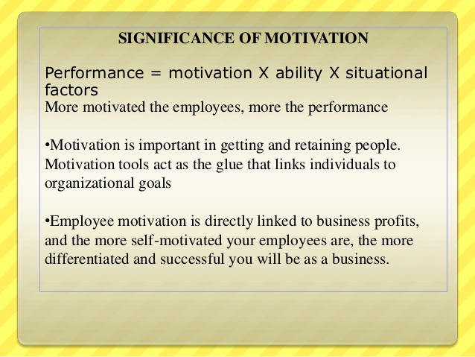

Slide 9
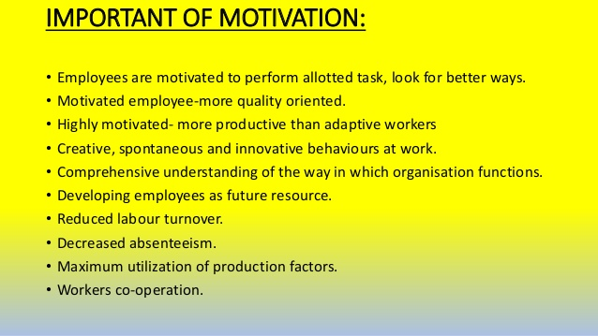

Slide 10
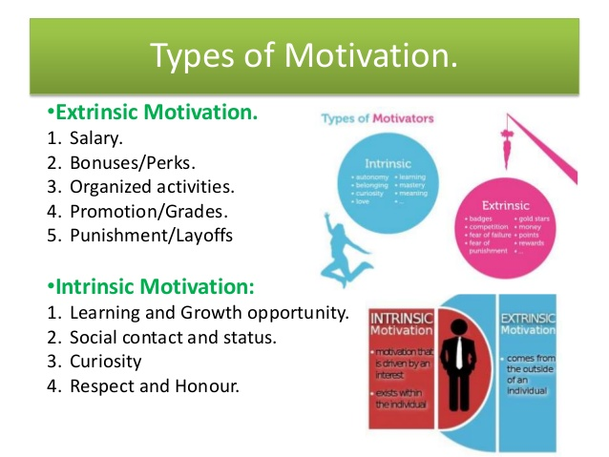

Slide 11
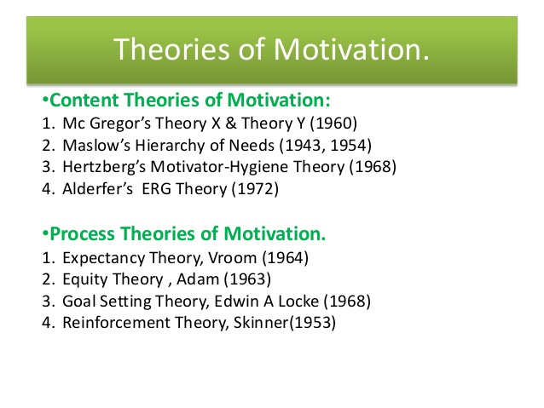

Slide 12
Hierarchy of Needs Theory (Maslow)
Hierarchy of Needs Theory
There is a hierarchy of five needs—physiological, safety, social, esteem, and self-actualization; as each need is substantially satisfied, the next need becomes dominant.
Self-Actualization
The drive to become what one is capable of becoming.

Slide 13
Maslow’s Hierarchy of Needs
Lower-Order Needs Needs that are satisfied externally; physiological and safety needs.
Higher-Order Needs Needs that are satisfied internally; social, esteem, and self-actualization needs.
Self
Esteem
Social
Safety
Physiological

Slide 14
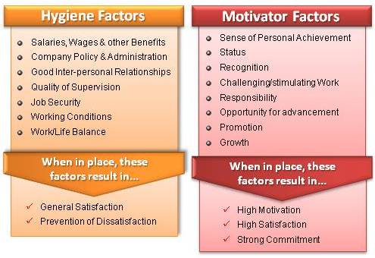
Herzberg’s Two-Factor Theory

Slide 15
Herzberg’s Two-Factor Theory
Bottom Line: Satisfaction and Dissatisfaction are not Opposite Ends of the Same Thing!
Hygiene Factors:
Salary
Work Conditions
Company Policies
Separate constructs
Hygiene Factors---Extrinsic & Related to Dissatisfaction
Motivation Factors---Intrinsic and Related to Satisfaction
Motivators:
Achievement
Responsibility
Growth

Slide 16
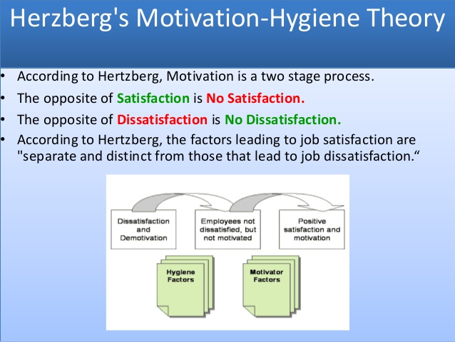

Slide 17
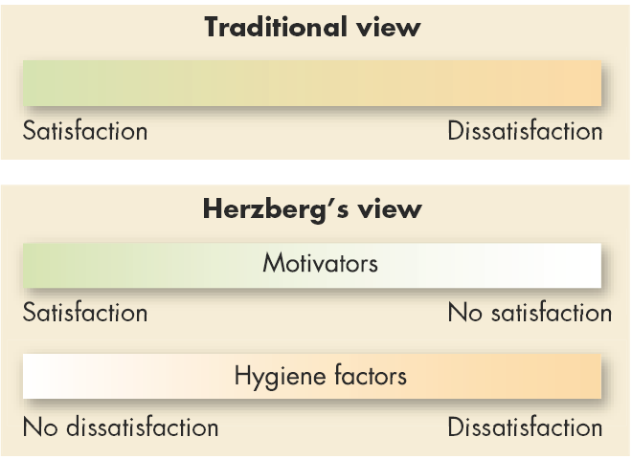
Contrasting Views of Satisfaction and Dissatisfaction

Slide 18
Having Little Ambition
Theory X
Managers See Workers As…
Disliking Work
Avoiding Responsibility
Self-Directed
Theory Y
Managers See Workers As…
Enjoying Work
Accepting Responsibility
Notes:
Douglas McGregor said that managers hold one of two sets of assumptions about human nature: either Theory X or Theory Y. Seeing people as irresponsible and lazy, managers who follow Theory X assume the following:
1. Employees inherently dislike work and will try to avoid it.
2. Since employees dislike work, they must be coerced, controlled, or threatened to achieve goals.
3. Employees avoid responsibilities and seek formal direction, if possible.
4. Most workers place security above all other work-related factors and will display little ambition.
Since they see people as responsible and conscientious, managers who follow Theory Y assume the following:
1. Employees can view work as being as natural as rest or play.
2. When committed to their objectives, people will exercise self-direction and self-control
3. The average person can learn to accept, even seek, responsibility.
4. Many workers besides managers have innovative decision-making skills.
No hard evidence confirms that either set of assumptions is universally true. It is more likely that the assumptions of Theory X or Theory Y may or may not be appropriate, depending on the situation at hand.

Slide 19
David McClelland’s Theory of Needs
Need for Achievement
The drive to excel, to achieve in relation to a set of standards, to strive to succeed.
Need for Affiliation
The desire for friendly and close personal relationships.
Need for Power
The need to make others behave in a way that they would not have behaved otherwise.
Bottom Line: Individuals have different levels of needs in each of these areas, and those levels will drive their behavior

Slide 20
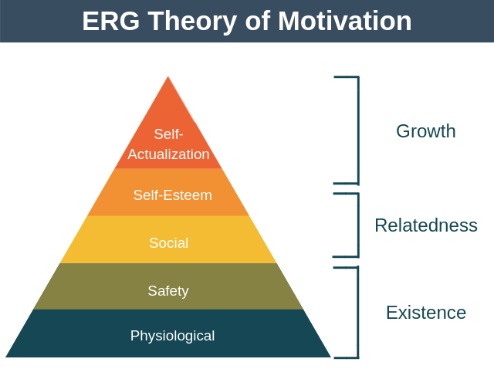
ERG theory
The ERG Theory of Motivation is a simplified but more flexible version of Maslow's hierarchy of Needs. It proposes three needs that must all be satisfied in order for an individual to be motivated: existence, relatedness, and growth

Slide 21
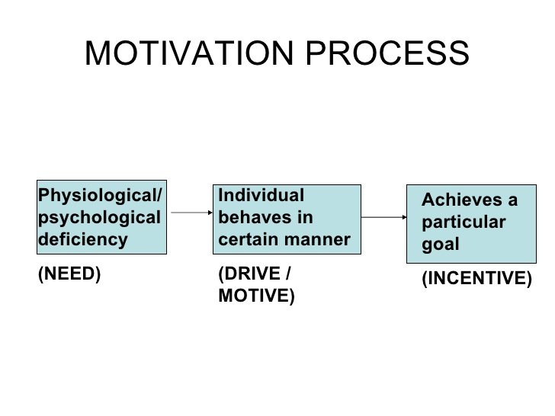

Slide 22
Expectancy Theory (Vroom)

Slide 23
Equity theory

Slide 24
Goal setting theory

Slide 25
Reinforcement theory

Slide 26
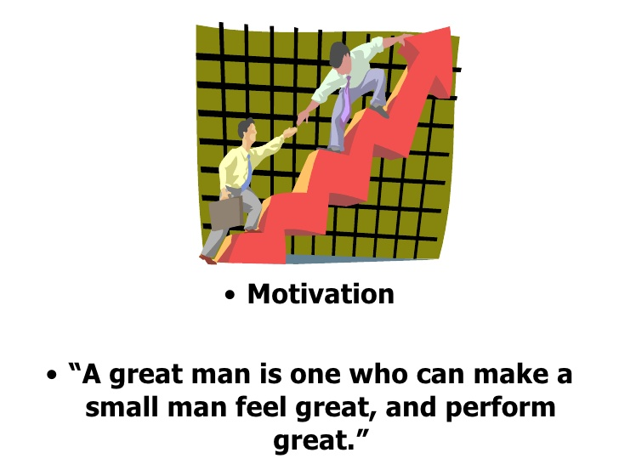

Slide 29
https://www.slideshare.net/anubijis/motivation-50837224
https://www.slideshare.net/karpagam93/motivation-42894219

